Slide 1
Strategies for Context
Data Persistence
Jason Fox, Senior Technical Evangelist
FIWARE Foundation

Slide 2
Learning Goals
What is data persistence and why do you need it?
Which data persistence options do you have?
What is Big Data?
Which FIWARE components are available to deal
with the persistence of context data?
Why do context brokers not offer a data persistence function of their own?
Subscriptions, Filtering and Data Preprocessing

Slide 3
Prerequisites
https://www.docker.com/
https://docs.docker.com/compose/install/
https://git-scm.com/downloads
https://www.getpostman.com/downloads/
https://www.cygwin.com/install.html
https://www.mongodb.com/download-center/compass
Docker
Docker Compose
Git
Postman
Cygwin for Windows
MongoDB Compass
git clone https://github.com/FIWARE/tutorials.Step-by-Step.git
cd tutorials.Step-by-Step/
git submodule update --init --recursive

Slide 4
FIWARE Catalogue
Real-time processing of context events (Perseo)
Creation of
Application Dashboards (Wirecloud)
Big Data Context Analysis (Cosmos)
Real-time Processing of media streams (Kurento)
Business Intelligence (Knowage)
Context Processing, Analysis, Visualization
Handling authorization and access control to APIs (Keyrock, Wilma,
AuthZForce, APInf )
Cloud Edge (FogFlow)
Development of
Context-aware applications
(Orion, Orion-LD, Scorpio,
STH-Comet, Cygnus,
QuantumLeap, Draco)
Core Context Management (Context Broker)
Data/API Management
Publication Monetization
Deployment tools
Publication and Monetization of Context Information (CKAN extensions, Data/API Biz Framework, IDRA)
Interface to IoT, Robotics and third party systems
Connection to the Internet of Things (IDAS, OpenMTC)
Connection to robots (FIROS, Fast RTPS,Micro XRCE-DDS)
Documents exchange (Domibus)

Slide 5
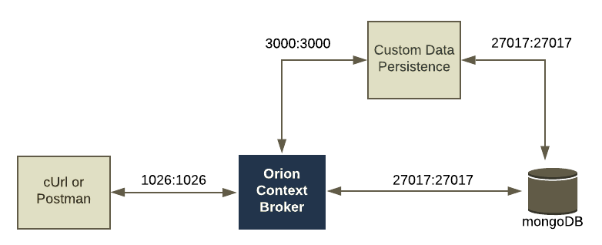
Data Persistence: Hello World
Use Case:
Dataset is limited.
Semi-static data entities within a single context broker
Coding Steps:
Write custom code to listen for notifications
Read incoming data
Upsert to a new separate Mongo-DB database
Create a one-off subscription / Cron-Job

Slide 6
Data Persistence Hello World
curl -L -X POST \
'http://localhost:1026/v2/subscriptions/' \
-H 'Content-Type: application/json' \
--data-raw '{
"description": "Building Entities to Mongo-DB",
"subject": {
"entities": [{
"idPattern": ".*",
"type": "Store"
}
]
},
"notification": {
"http": {
"url": "http://tutorial:3000/building/subscription"
},
"attrsFormat": "keyValues"
},
"expires": "2017-01-01T14:00:00.00Z"
}'
Filtering
id or idPattern
type or typePattern
Narrow the query down further using the conditions block:
q
attrs
Payload Format
keyValues or normalized
Frequency
expires in the past
throttling

Slide 7
Hello World : Pros and Cons
Pros:
Simple Solution - gives developer quick access to Mongo-DB syntax
Useful if context broker query language cannot directly service my needs:
Natural Language Support
Alphabet Sorting
Cons:
Specific Point Solution
Lack of scaling - single DB, single microservice
Throughput is limited
No community support - lack of bug fixes, support for NGSI-LD etc.

Slide 8
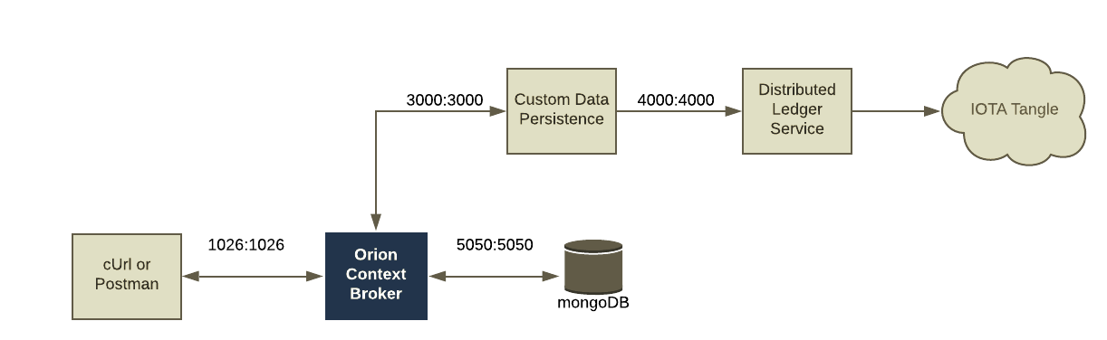
Custom Sink: Data Persistence to a Distributed Ledger
Common Steps
Receive a subscription
Iterate across the entities found
Massage the data (optional)
Persist.
Example Service - FIWARE to IOTA
https://github.com/singhhp1069/FIWARE-IOTA-SERVICE
Integrated Library - FIWARE to IOTA
https://github.com/singhhp1069/fiware-iota

Slide 9
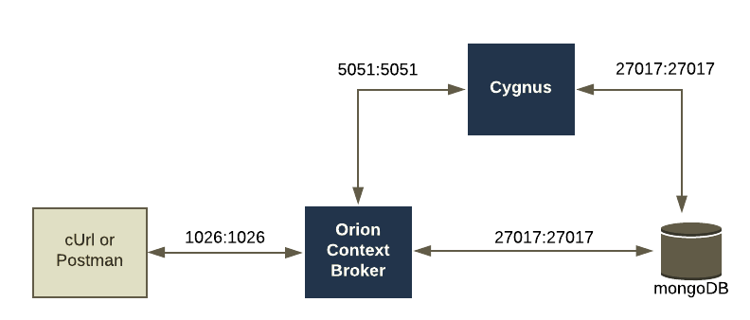
Cygnus: Data Persistence using Apache Flume
Apache Flume
“Distributed, reliable, and available service for efficiently
collecting, aggregating, and moving log data”
Documentation: https://flume.apache.org/
Separate Ports for each input
Configured via
config files
Sinks available for: CartoDB, CKAN, DynamoDB, ElasticSearch, HDFS, Hive, Http, Kafka, MongoDB, MySQL, Orion, PostGres,
Cygnus Documentation: https://fiware-cygnus.readthedocs.io/en/latest/

Slide 10
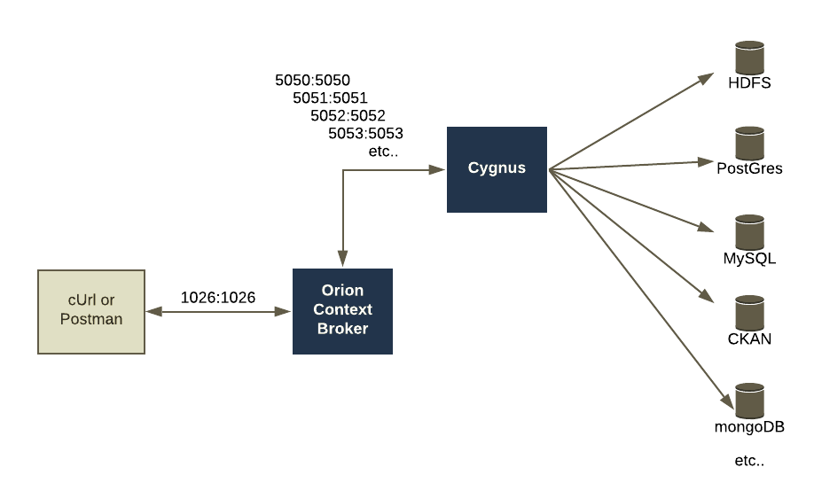
Cygnus : Advanced Scenario - Multiple Sinks
Create a config for each sink
configuration as code
Create a subscription to pass appropriate
data to the right port
Use debug to check the configuration is working properly

Slide 11
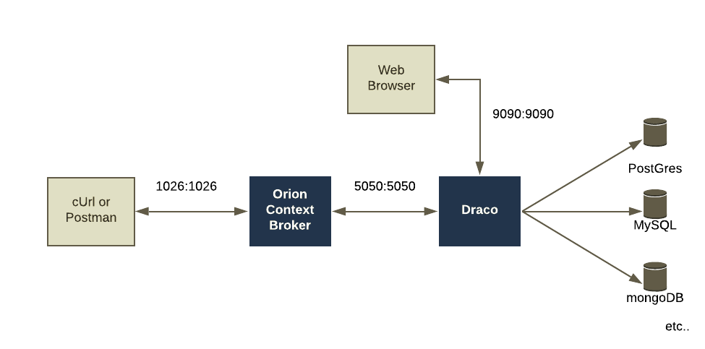
Draco - Data Persistence using Apache NIFI
Apache NIFI
“Scalable directed graphs of data routing,
transformation, and system mediation”
Documentation: https://nifi.apache.org/
Listens on a Single Port
Configured by a Graphical Interface
Sinks available for: Cassandra, HDFS, MongoDB, MySQL, PostGres, CartoDB
Draco Documentation: https://fiware-draco.readthedocs.io/en/latest/

Slide 12
Summary
Data Persistence gives a “memory” to context data:
Context Brokers only hold the latest value of context data
Push to a Database to create logs and analyse changes of state
Don’t use a Context Broker as a database.
Use a context broker to do context broker things - e.g. augmented context
Use databases to do database things - e.g. Logging, Natural Language support
The FIWARE Catalogue contains two components to facilitate data persistence:
Cygnus - based on Apache Flume
Draco - based on Apache NIFI
Basic use cases are the same - different underlying technology
Create your own Point Solution if necessary
Handle the subscription endpoint
Push to custom Sink - e.g. Blockchain

Slide 13
Summary: Data Persistence Architectures
When architecting a solution, think about:
The amount of data produced
Storage and backup
How long to retain data?
GDPR and the right to forget
How to scale - can you fit it into a single database?
Do you need to consider a distributed Big Data solution?
Context Brokers do not offer data persistence directly , because the data persistence needs will vary between Smart Solutions

